Slide 1
Chapter -6
JavaScript

Slide 2
JavaScript is a cross-platform, object-based scripting language invented specifically for use in web browsers to make websites more dynamic and attractive.
Introduced by Netscape.
Scientist - Brenden Eich

Slide 3
A script is a segment of code that manipulates the browser and its contents.

Slide 4
*Features of JS
It is a great programming tool for HTML.
It is a powerful scripting language.
Saves time.
Easy for the programmers to understand.
DOM- Document Object Model
- Dom defines the logical structure of the document.
Change page contents dynamically- Easy to change the elements in the forms.

Slide 5
*Java Vs Java Script
Java | JavaScript
Java is a high level object-oriented | * JavaScript is a high level object based
programming language. | scripting language.
Java is both compiled and interpreted | * JavaScript is interpreted language and does
language | not require compilation.
Java is complex language. | *JavaScript is simpler and easy to learn.
After every alteration compilation is required. | No Compilation is required.
Class based object model | Prototype based model

Slide 6
Object Orientation and JS
JavaScript is a concept which uses OOP techniques.
The basic Concepts are:
Object – The web page document is an object, forms, buttons or images are objects.
Methods-An action that can be performed on an object is called a method. Ex. document.open to open a new document
Events – Triggers used to run the function
Ex- onclick

Slide 7
JavaScript syntax
<script type=”text/JavaScript”>
JavaScript code
</script>
Where type attribute: This attribute indicates the scripting language in use and its value should be set to “text/javascript”.

Slide 8
Eg
<head>
<script type =“text/javascript”>
</script>
</head>

Slide 9
*Comment Tag
Comments are non executable statements
Two Types
1. Single Line comments -- //
example :- /This is a sample program/
2. Multiline Comments-- <! -- >
example: <! – This is a sample program
you can write multiple line comments-->

Slide 10
Javascript keywords
Keywords are words that have a specific meaning in a programming language.
Eg : Break, while, var, else, continue, return, void etc,

Slide 11
*Data types in JS
JS supports 2 main types of data.
→ Primitive - Which are pre defined.
→ Composite – can be derived from primitive.- Arrays & functions.
JavaScript supports five primitive data types:
1. Numbers
2. strings
3. Booleans
4. undefined
5. null

Slide 12
Numbers: Accepts numerical values.
As the name implies, a number type refers to numerical values. Numbers can be divided into two groups:
floating-point — are fractional numbers such as 2.45, -3.58, and .97
Integers — are whole numbers without decimal points such as 245, -480, and 3.

Slide 13
Strings:
A string type refers to one or more characters of text. In JavaScript, a string is enclosed inside single or double quotes.
Ex:"Scripting Language", 'HTML', 'JavaScript', and "1999", are all examples of strings.

Slide 14
Booleans:
In JavaScript, Boolean logic allows our program to make decisions. A Boolean logic statement consists of a condition that evaluates to either true or false.
The possible values the Boolean can take are:
Yes or no
On or off
Positive or negative
True or false

Slide 15
Undefined type
The undefined type refers to those variables or object properties that are either undefined or do not exist.
When a variable, is declared without assigning a value to it, it is of undefined type.

Slide 16
Null type
The null type indicates an empty value. When a variable is assigned the value null, its type becomes null.
var Age = null;

Slide 17
*JavaScript Variables
A variable is a named element used to store and retrieve information. Its value will be changing during the execution of a program.
Declaring JavaScript Variables: The process of creating a variable is known as variable declaration. By declaring a variable we are allocating memory space for that variable.
You declare JavaScript variables with the var keyword:
Ex:
var x;
var carname;

Slide 18
Rules for declaring variables:
reserved words cannot be used as variable names.
Variable names must begin with a letter, the $ character, or the underscore character.
It cannot contain any space characters.
Variable names are case sensitive (y and Y are two different variables).

Slide 19
Assigning values to be variables.
After we declare a variable using var we can assign values to the variable.
We can also assign values to the variables. when we declare them:
Ex:
var x=5;
var carname="Volvo";

Slide 20
*Variable scope in JS
The availability or accessibility of a variable within the executing program is referred to as Variable scope.
Variable scope is of two types:
Local Scope
Global Scope

Slide 21
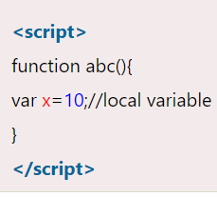
Local JavaScript Variables
A variable declared within a JavaScript function becomes LOCAL and can only be accessed within that function. (the variable has local scope). Local variables are destroyed when you exit the function.

Slide 22
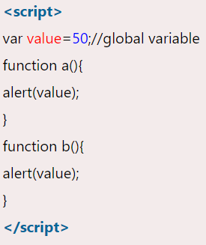
Global JavaScript Variables
Variables declared outside a function become GLOBAL, and all scripts and functions on the web page can access it.
Global variables are destroyed when you close the page.
If you declare a variable, without using "var", the variable always becomes GLOBAL

Slide 23
Operators
Are used to perform certain set of operations.
They are 2 types
Unary Operators – operates on single operand
eg: i++
Binary Operators – operates on two operands.
Eg: a= 5, a+b

Slide 24
Arithmetic operators:
Operator
+
-
*
/
%
++
--

Slide 25
The Assignment Operators: they are used to assign values to variables.
=
+=
-=
/=
*=
%=

Slide 26
Comparison operators(relational operators)
It is used to compare the variables. Its output will be true or false.
== → 5==5
> → A>B
<= → 4<=5
>= → 7>=6
!= →4!=5

Slide 27
Increment & Decrement
The increment and decrement operators in JavaScript will add one (+1) or subtract one (-1), respectively, to their operand, and then return a value.
Increment — x++ or ++x
Decrement — x-- or --x

Slide 28
Logical operators
The logical operators are used to connect two or more Boolean expressions.
Ex: (4 > 2) && (10 < 15)
&& If (A>B) && (A>C)
||
!

Slide 29
Methods:
Methods are the actions that can be performed on objects.
Ex: We can write “hello world” into a document by typing.
document. write(“hello world”).

Slide 30
Properties:
Properties are the values associated with an object.
Ex: background colour is one of the property of document object.

Slide 31
*The Math object
The Math object allows you to perform mathematical tasks.
Math object in JavaScript need not be defined.
The two attributes for the math objects are
→ properties
→ methods

Slide 32
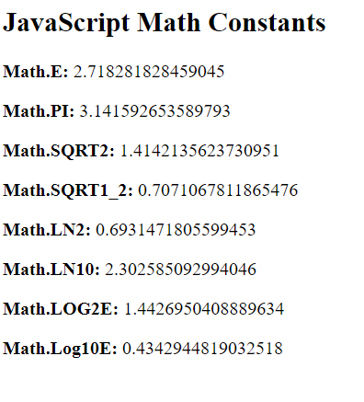
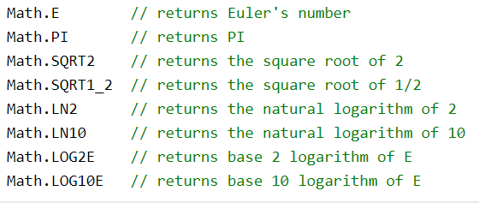
Properties of Math Object:

Slide 33
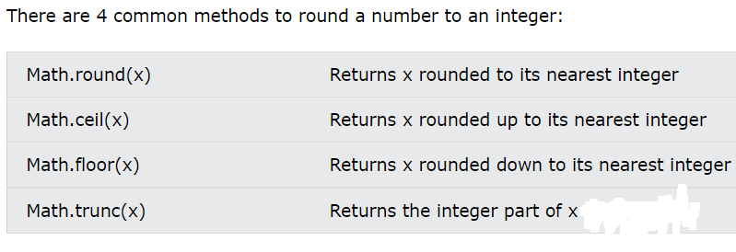
Methods of math object
Eg: Math.round(4.2); // returns 4
Math.ceil(4.7); // returns 5
Math.floor(4.9); // returns 4
Math.trunc(4.2); // returns 4

Slide 34
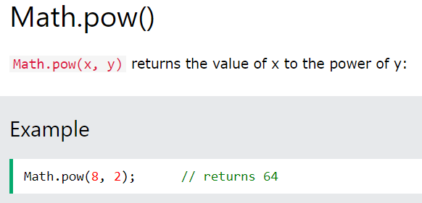
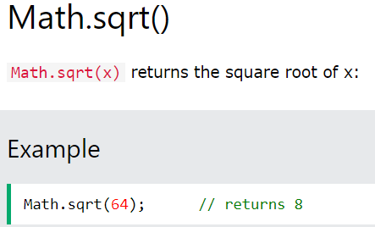

Slide 35
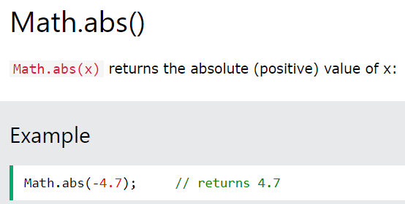
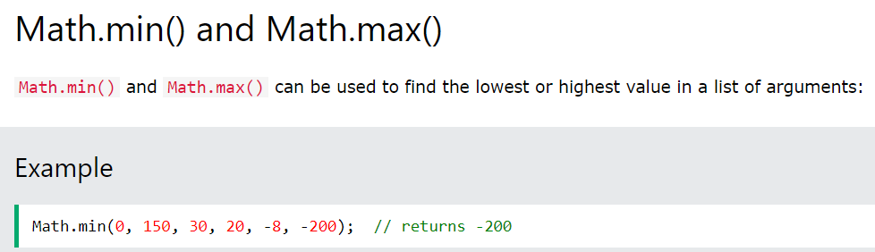


Slide 36
*Number Object
The JavaScript number object enables you to represent a numeric value. It may be integer or floating-point. .
Number Object Methods
isinteger()
parseInt()
toExponential()
toFixed()
toPrecision()

Slide 37
isInteger()
The JavaScript number isInteger() method determines whether the given value is an integer. It returns true if the value is an integer, otherwise it returns false.
Eg: isinteger(4.4) - will return false

Slide 38
parseInt()
he JavaScript number parseInt() method parses a string argument and converts it into an integer value.
Eg:var e="50.25String"
document.writeln(Number.parseInt(e));
Will return 50

Slide 39
toExponential()
The JavaScript number toExponential() method converts the given number into an exponential notation and returns it in the form of string.
Eg:
var a=989721;
document.writeln(a.toExponential());
Will return 9.89721e+5

Slide 40
toFixed()
The JavaScript number toFixed() method returns the string representing a number that has exact digits after the decimal point.
Eg:
var a=98.9721;
document.writeln(a.toFixed()); will return 99

Slide 41
toPrecision()
he JavaScript number toPrecision() method returns the string representing a number of specified precision.
Eg:
var a=98.9721;
document.writeln(a.toPrecision(2)); will return 98.97

Slide 42
*The Date Object
The Date object is used display current date and time on the web page.
 | Methods | Description
 | getSeconds() | Return the seconds
 |  | Number in the range 0 to 59
 | getMinutes() | Returns the minutes
 |  | Number in the range 0 to 59
 | getHours() | Returns the hours
 |  | Number in the range 0 to 23
 | getDate() | Returns the date of the month
 | getDay() | Returns the day of the week
 |  | Number in the range 0 to 6
 | getMonth() | Returns the month of the year
 |  | Number in the range from 0 to 11
 | getFullYear() | Returns the year number
 | getTime() | Returns the time value , expressed as number of milliseconds since January
 |  | 1, 1970 12 am

Slide 43
*The String object
The String object is used to manipulate a stored piece of text.
String | Description
Method
charAt() | Returns the character at the specified index
indexOf() | Returns the position of the first found occurrence of a specified value in a string
lastIndexOf() | Returns the position of the last found occurrence of a specified value in a string
search() | Searches for a match between a regular expression and a string, and returns the
 | position of the match
strlen()
 | through the specified number of character
substring() | Extracts the characters from a string between two specified indices
toLowerCase() | Converts a string to lowercase letters
toUpperCase() | Converts a string to uppercase letters

Slide 44
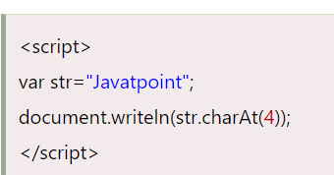
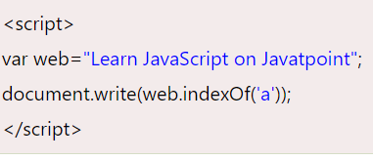
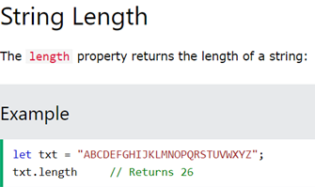
charAt()
Will return t
indexOf()
Will return 2

Slide 45
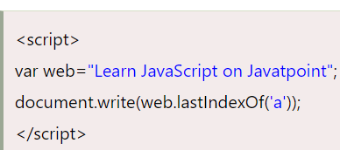
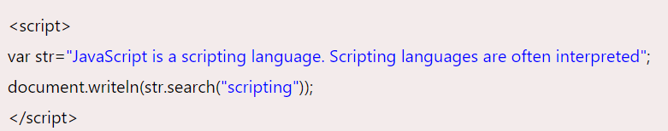
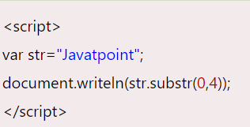
lastindexOf()
Will return 23
search
Will return 16
Substr()
Will return java

Slide 46
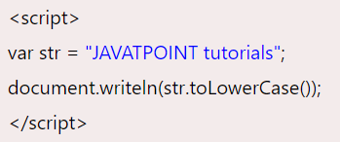
toupper() &tolower
Will return javapoint tutorials

Slide 47
The typeof Operator
The Javascript typeof operator returns the datatype of an operand. The return values are boolean , number, object,string, or undefined. Ex:
var a=120;
var str=”WEB”
typeof(a)->number
typeof(str)->string

Slide 48
*Type Conversion
Process of converting one data type to another.
Two Types
-> Implicit – Automatic type Conversion
-> Explicit- User Conversion

Slide 49
Explicit- Conversions from String To Numbers:
To convert a string to a number, use the JavaScript functions
parseFloat (for conversion to a floating-point number)
parseInt (for string-to-integer conversion).

Slide 50
**Screen output & Keyboard input methods.
The functions or the methods which are used to display the outputs are called screen output methods.
The functions or the methods which are used to take input from user is called keyboard input methods.

Slide 51
*Methods to show output
document.write( )
document.writeln( )
window.alert( )
window.status

Slide 52
document.write() or document.writeln()
These two methods are used for displaying text on a web page.
Syntax:
1.document.write(“sometext”);
2. document.writeln(“sometext”);
document is an object and both write() and writeln() are methods of document object.
write() method prints the text to the browser without attaching a carriage return at the end of the text while writeln() method adds a carriage return to the end of text.
Ex: document.write(“Sindhi”); document.writeln(“Sindhi”);
document.write(“College”); document.writeln(“College”);
o/p – SindhiCollege o/p – Sindhi
College

Slide 53
window.alert()
The alert() method is part of window object and is used to send a warning to the user or alert him or her to do something.
The alert() shows the message in a small message box .
The message contains the string and an “OK” button on it.
If the user presses the “OK” button the message box dispappears.

Slide 54
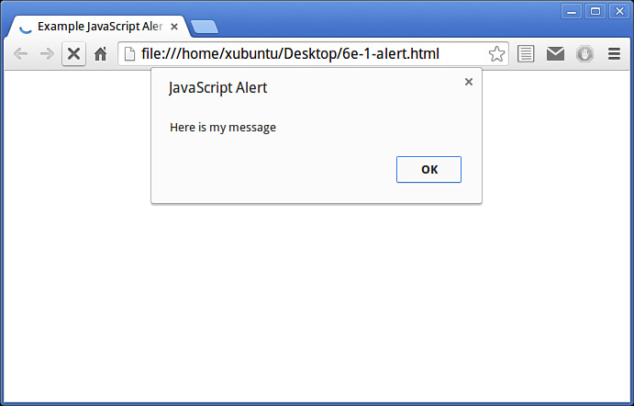
Ex:window. alert(“here is my message!);

Slide 55
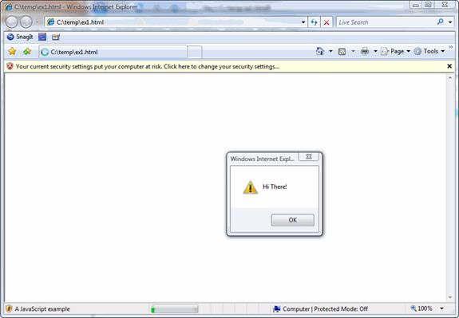
window.status();
The window.status property is used to display the message on the status bar.

Slide 56
*Methods to take input
window. prompt()
Window. confirm()

Slide 57
Window.prompt()
It helps the user to type some text.
The prompt method creates a dialogue that contains the textbox which is used to collect a string of input from the user. And the prompt returns its values. The window consists of an OK button and Cancel button.

Slide 58
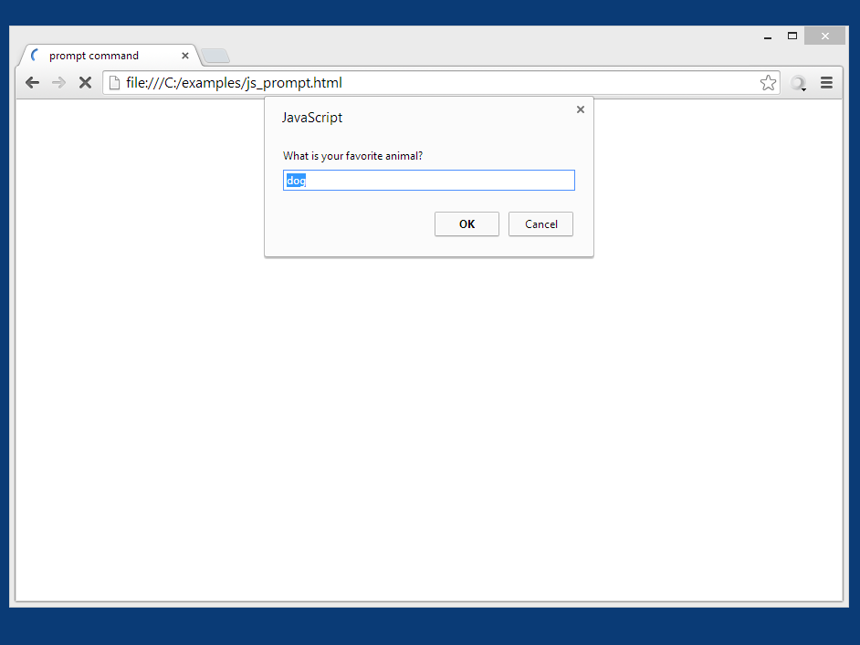
window. prompt(“which is your favourite animal?");

Slide 59
Window. confirm()
The confirm dialog box is used to confirm a user’s answer to a question. The user must agree before the action s completed. A question mark(?) will appear in the box with an OK button and Cancel button

Slide 60
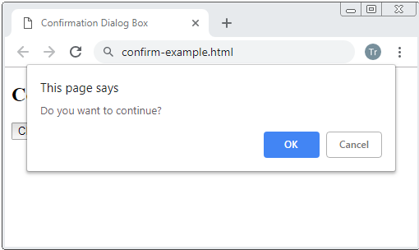
Eg: window. confirm(“Do you want to Continue?”);

Slide 61
Conditional statements
Conditional constructs control the flow of a program. If a condition is true , the program will executes a block of statements and if the condition is false , flow will go to an alternate block of statements.
if statement
if...else statement
if...else if....else statement
switch statement

Slide 62
if statement
Use the if statement to execute some code only if a specified condition is true.
Syntax
If(condition)
{
Statements;
}
Eg:-
<script>
if (time < 10)
{
document.write("<b>Good morning</b>");
}
</script>

Slide 63
If...else Statement
Use the if....else statement to execute some code if a condition is true and another code if the condition is not true.
Syntax
if (condition)
{
statement1;
}
else
{
statement 2;
}

Slide 64
Example- if- else
<script language="JavaScript">
num=11;
if(num%2==0)
{
document.write(“The number is even");
}
else
{
document.write("The number is odd");
}
</script>

Slide 65
If...else if...else Statement
Use the if....else if...else statement to select one of several blocks of code to be executed.
Syntax
if (condition1)
{
Stmt1;
}
else if (condition2)
{
stmt2
}
else
{
Stmt3;
}

Slide 66
Example
if (marks >80)
{
document.write(“Distinction");
}
else if (marks >60)
{
document.write(“First Class");
}
else if (marks >50)
{
document.write(“Second Class");
}
else if (marks >35)
{
document.write(“PassClass");
}
else if (marks <35 )
{
document.write(“Fail");
}

Slide 67
Switch Statement
Use the switch statement to select one of many blocks of code to be executed.
Syntax:
switch(condition)
{
case 1 : Value 1
break;
case 2 :Value 2
break;
:
:
default :Default value;
break;
}

Slide 68
Example
switch (Day)
{ case 1:document.write(“MONDAY");
break;
case 2 :document.write(“Tuesday");
break;
case 3: document.write(“wednesday");
break;
:
:
default:document.write(“invalid”);
}

Slide 69
Looping or iterative statements
Looping or iteration control is used to execute some set of instructions repeatedly.
while loop:
A while loop runs the same block of code while or until a condition is true.
The general syntax for creating a while loop is:
while (condition) {
statmts;
}

Slide 70
Example
while (i <= 5)
{
document.write (i + " ");
i++;
}

Slide 71
do…while loop
A do loop runs once before the condition is checked .
If the condition is true , it will continue to run until the condition is false.
Syntax
do
{
Statmnts;
}
while (Condition);

Slide 72
Example
do
{
document.write (i + “ ");
i++;
} while(i<=5);

Slide 73
for loop:
A for loop runs the same block of code a specified number of times.
for (startingValue, condition, iterationValue)
{
statmts;
}

Slide 74
Example
for (I=1; i<=5; i++) {
document.write(“Sum");
}

Slide 75
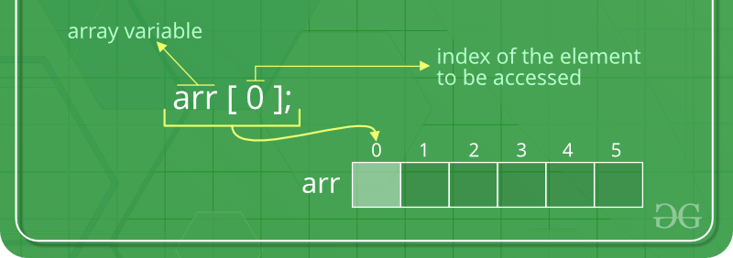
JavaScript Arrays
An array is an ordered collection of values that is grouped together by a single variable name.
Array is a collection of similar data elements with all of the same name and type.

Slide 76
*Creating an Array
An array in JS can be created using an array literal, which is a list of values enclosed in brackets.
In C Program
int array[5]={ val1,val2….}
Syntax in JS:
var array _name=[item1,item 2,….]
Eg: var array_places=[“Agra”,”London”,”Banglore”];

Slide 77
Creating Array using the keyword new
Syntax:
var array_name= new Array();
Eg:
var array_car=new Array();
array_car[0] = “Santro”;
array_car[1] = “Maruthi”;
array_car[2] = “Hyundai”;
:
:
new array can store 100 elements by default

Slide 78
*The Array Methods
Length()
Push()
Pop()
Shift() & Unshift()
Reverse();
Sort()
Concat()
slice()

Slide 79
Length() Method
This property is used to count the number of elements in an array
eg:
var fruits=[“mango”,”apple”, “orange”];
fruits.length will return 3

Slide 80
Push() Method
The push() method adds new elements to the end of an array, and returns the new length.
Ex: var fruits = ["Banana", "Orange", "Apple", "Mango"];
document.write(fruits.push("Kiwi"));
output:Banana,Orange,Apple,Mango,Kiwi .

Slide 81
Pop() Method
The pop() method removes the last element of an array, and returns that element.
Ex: var fruits = ["Banana", "Orange", "Apple", "Mango"];
document.write(fruits.pop( ));
output: Mango will get deleted.

Slide 82
Shift() Method
The shift() method removes the first element of an array, and returns that element.
Ex: var fruits = ["Banana", "Orange", "Apple", "Mango"];
document.write(fruits.shift());
output: Banana will get removed

Slide 83
Unshift() Method
The unshift() method adds new elements to the beginning of an array, and returns the new length.
Ex: var fruits = ["Banana", "Orange", "Apple", "Mango"];
document.write(fruits.unshift("Kiwi"));
output: Kiwi,Banana,Orange,Apple,Mango

Slide 84
Reverse Method()
The reverse() method reverses the order of the elements in an array (makes the last element first, and the first element last).
Ex: var fruits = ["Banana", "Orange", "Apple", "Mango"];
document.write(fruits.reverse());
Output: Mango,Apple,Orange,Banana

Slide 85
Sort() Method
The sort() method arrange the elements of an array in their alphabetical order.
Ex: var fruits = ["Banana", "Orange", "Apple", "Mango"];
document.write(fruits.sort());
output: Apple,Banana,Mango,Orange

Slide 86
Concat() Method
The concat() method combines the elements passed as arguments onto an existing array, returning a new combined list.
This method does not change the existing arrays, it only returns a copy of the joined arrays.
Ex: var parents = ["Jani", "Tove"];
var children = ["Cecilie", "Lone"];
var family = parents.concat(children);
document.write(family);
output: "Jani", "Tove""Cecilie", "Lone"

Slide 87
Slice () Method
The slice() method selects a part of an array, and seperates and returns a new array.
Ex: var fruits = ["Banana", "Orange", "Apple", "Mango"];
document.write(fruits.slice(0,2));
output: Banana Orange
Apple, Mango

Slide 88
*JavaScript Functions
A function is a series of commands that either calculates a value or performs an action.
It consists of Function name, parameter values to the function and a set of commands that runs from the function.
In order to use a function we should define first.
The name of the function tells which type of function.

Slide 89
The general syntax of a JavaScript function is:
function functionName (parameters)
{
JavaScript commands
}
where
functionName = name of the function
parameters = values sent to the functions
JavaScript commands = commands that run when the function is called or used .
A function starts with the keyword function.
All the commands that belong to a function must be placed inside the curly braces { }.
The set of commands placed inside the curly braces is referred to as a commands block.
The commands block combined with the function name is referred to as a function definition.

Slide 90
Example
function isEven (num)
{
if (num % 2 == 0)
{
Return num;
}
}

Slide 91
*Pattern Matching using Regular Expressions.
Pattern matching is the process of searching a text. It is a text searching technique used in JavaScript for form validation, replacing text, processing user input.
Regular expressions are used to search a text from group of strings. Regular expressions are a method of searching which is defined by American Mathematician Stefen Kleene.

Slide 92
Regular Expressions
Regular expression is a pattern of characters following a specialized syntax used to search text for a matching pattern.
Eg:- .in will find win in windows
Email format: The regular expression for email is
/^[a-zA-Z0-9._-]+@[a-zA-Z0-9.-]+\.[a-zA-Z]{2,4}$/
It is simple way to check quickly whether a given string is their in your document or not.

Slide 93
**Pattern Matching Methods
Match() Method
A match method is used to search for a pattern of character in a string and returns an array where each element of the array contains a matched pattern. If no matches are found then it returns a null value.

Slide 94
Ëxample
Eg:- MatchArray = String.match(reg.exp);
regexp=“nit”
O/P - Unity, Unit
Unity
Hello
Hai
Unit
University

Slide 95
Search() Method
A search method is used to search a pattern of character within a string and returns the index position of where the pattern was found. The index starts at 0 and if the pattern is not found it will return -1

Slide 96
Example
Eg:- NewArray = String.search(reg.exp);
regexp=“nit”
O/P - 0 and 3
Unity
Hello
Hai
Unit
University

Slide 97
Replace () Method
Replace method is used to search for a string and replace the string with another string.
Eg :- :- NewArray = String.replace(“Hello”,”How”);
Unity
Hello
Hai
Unit
University
Unity
How
Hai
Unit
University

Slide 98
Split() Method
Split method is used to split a single text string into an array of substrings.
Eg:- var string =“HelloHowAreYou”;
split array=string.split(string);
Hello
How
Are
You

Slide 99
*Errors in Script
An error describes any issue that arises unexpectedly that cause a computer to not function properly.
3 types
Load or Compile time error
Run time Error
Logical Error

Slide 100
Load or Compile time error
Compile time errors are that occurs when a script is been loaded. These errors will prevent the script from running at all.
Some type of syntax errors are compile time errors

Slide 101
Runtime errors
Runtime errors occurs during the execution of the script.
Eg – it will occur when a head is not properly closed or any tag is not properly closed.

Slide 102
Logical error
These are very hard to find out as it occur only during the wrong usage of logic
eg;- == and =

